Slide 1

Used Car Data Analysis & Price Prediction
By: Mohaib & Neetu

Slide 2

Research Topic:
Predict value of used cars based on factors such as: make and model and year of make of the car, number of accidents, number of owners and mileage
Data Source:
The dataset can be found and downloaded from the following link:
https://www.kaggle.com/code/pandu0/car-resale-price-prediction-scikit-learn/input
This dataset contains about 2300 rows of data

Slide 3
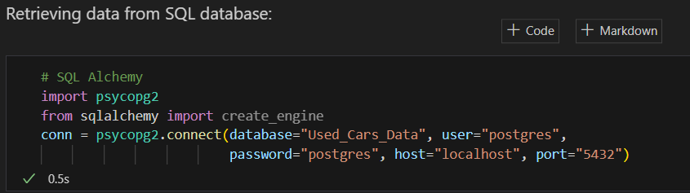
SQL Database:
The initial dataset was cleaned in Jupyter Notebook
A SQL database was created with the revised dataset
Data was fetched from SQL database into Jupyter Notebook prepared for performing an analysis & pre-processing & training the model

Slide 4
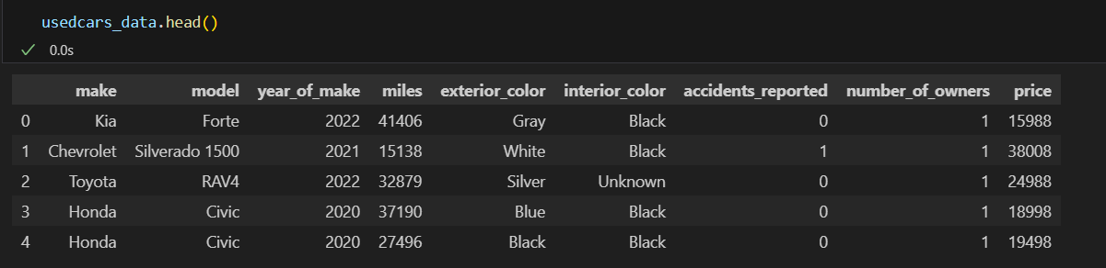
Data Cleaning & Analysis:
Data was reviewed to identify if the factors below contributed to determining a used vehicles price

Slide 5
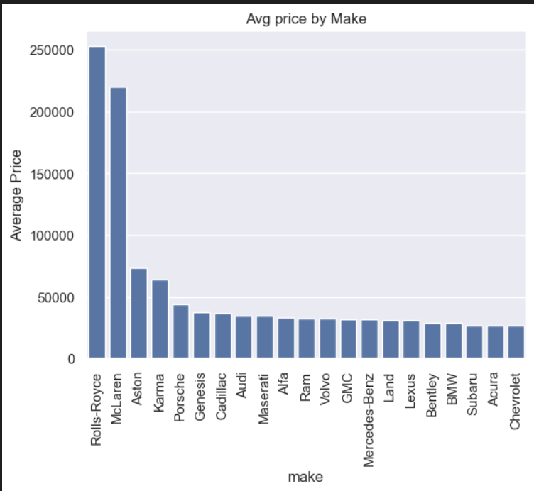
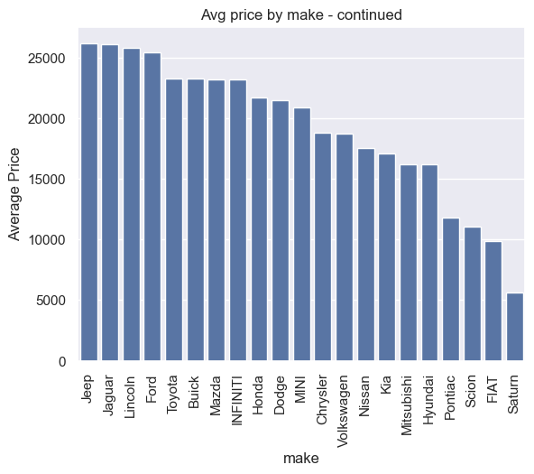
Observation:
“Make” has an impact on the price of the car

Slide 6
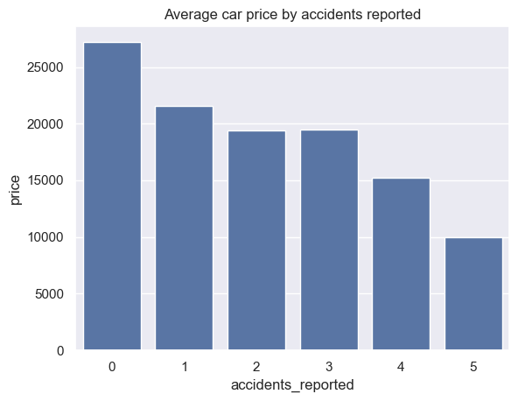
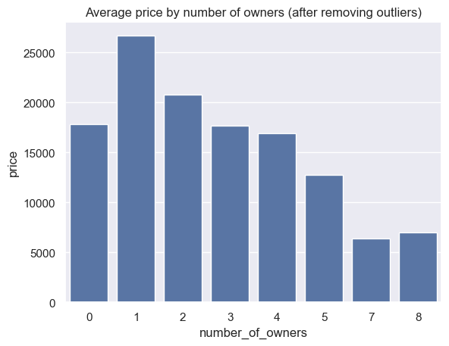
Observation:
Observation:
Number of accidents have a big impact on the vehicles price
Number of previous owners has a big impact on the vehicles price as well

Slide 7
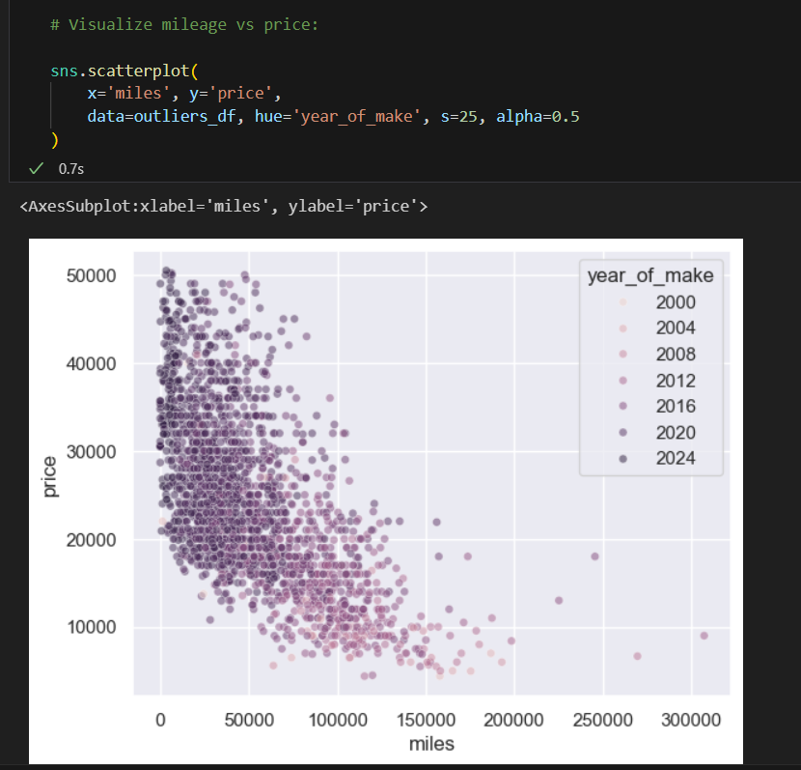
From this graph, we can see mileage contributes to determining the price however it is not the only factor determining the price. Other factors such as number of previous owners, accidents, make and model, year of make are also factors determining the price.

Slide 8
Data Modelling:
As the objective was to predict price we decided to use 2 supervised learning models:
Random Forest Regressor
K Neighbors Regressor
Following functions were used:
Initializing simple imputer
Translate categorical values to numeric values using OneHotEncoder function
Data was split into train and test datasets

Slide 9
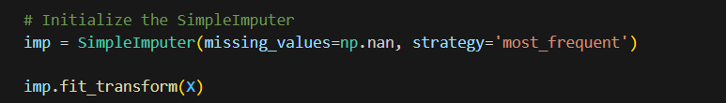
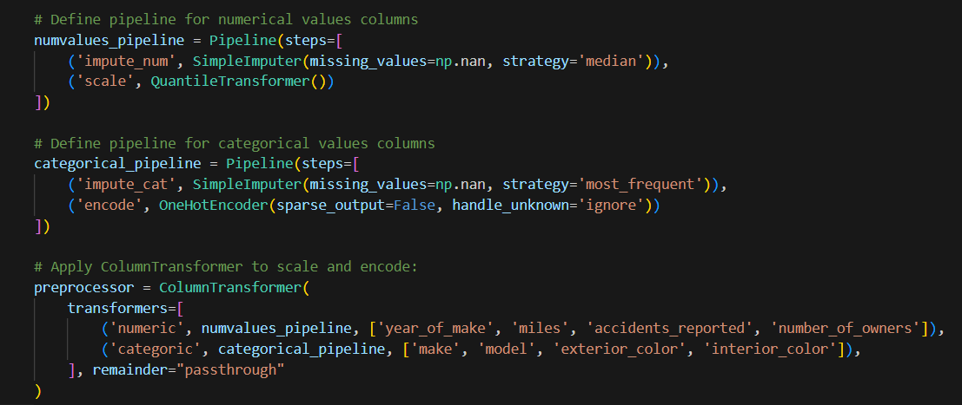

Slide 10
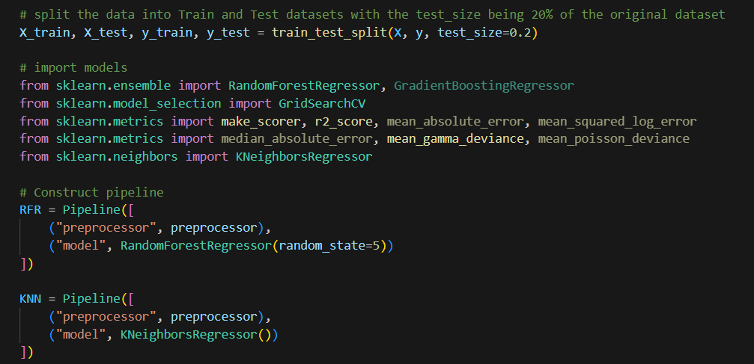
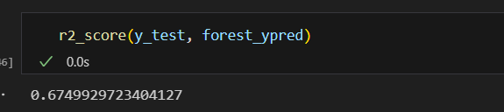

Slide 11
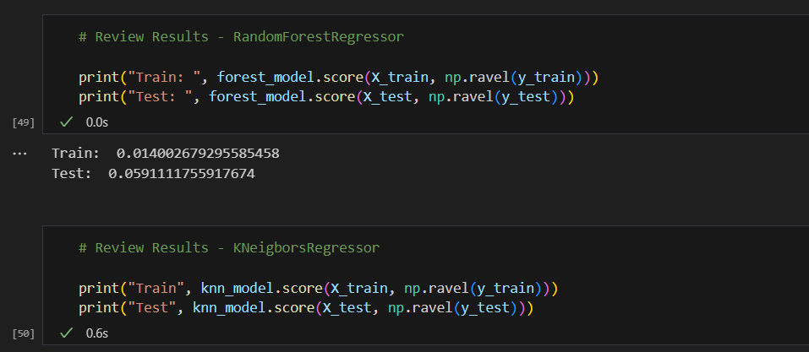

Slide 12
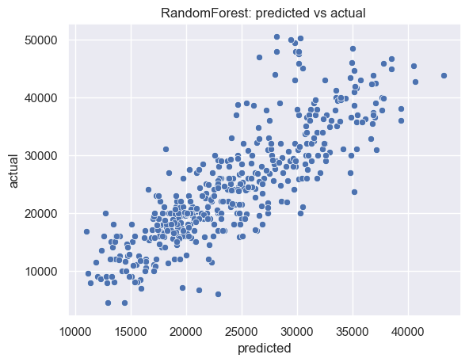
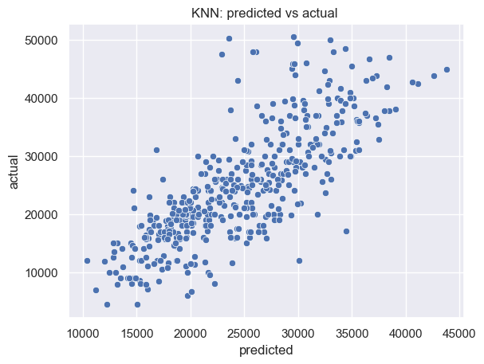

Slide 13
We created another model using TensorFlow to see if we could obtain better results
Steps to create deep learning model:
Define X (independent variables) and y (dependent variables).
Split the data into Train and Test datasets
Convert categorical data to numeric with OneHotEncoder.
Create a QuantileTransformer instance.
Fit the scaler and scale the data.
Define the model - deep neural net, i.e., the number of input features and hidden nodes for each layer
Compile and train the model. Compile metrics was RSquare to predict the car values.
Evaluate the model. Plot the results.

Slide 14
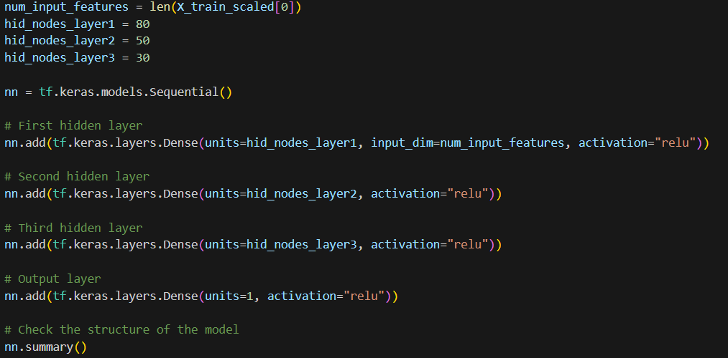
STEP 6 (figure 1.0

Slide 15
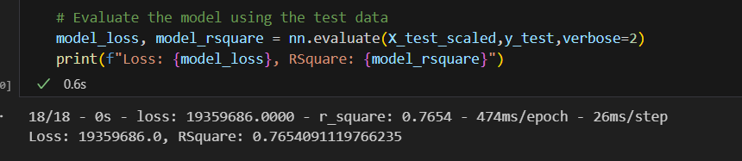
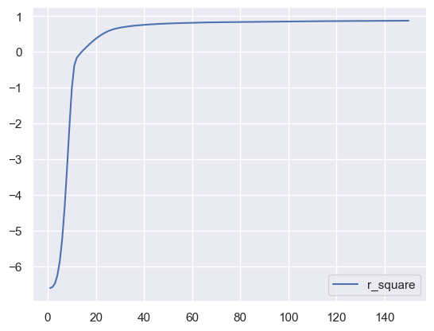

Slide 16
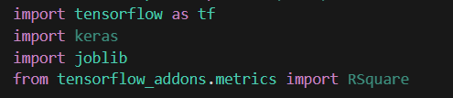

Test the model
Create another jupyter notebook, import libraries.
2. Clean and scale the data.
3. Load the model
4. Input the data into the model and predict the values.

Slide 17
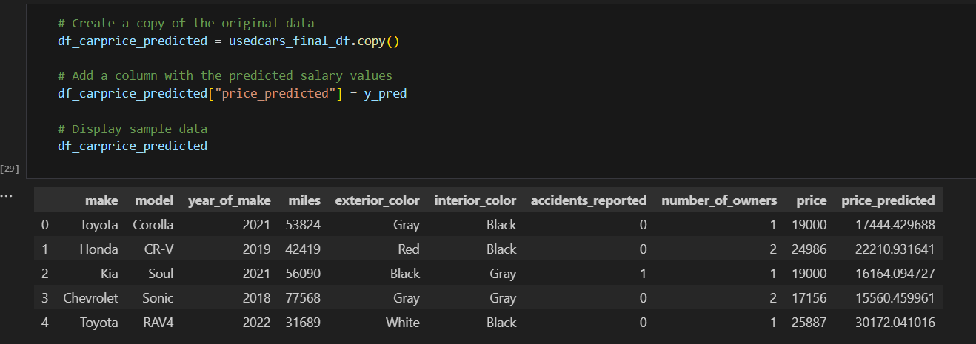
Summary:
The value of used vehicle prices are based on a set of categorical and objective factors, including, but not limited to, previous owner count and accident history, make, model etc. Although we must recognize the influence of regional variations, economic conditions, profit margins that dealerships are seeking, and demand on the market price range of used vehicles. Despite falling slightly below the targeted R2 score of 0.80, the model exhibits substantial accuracy, achieving an R2 score of 0.77. The minimal difference between predicted and actual prices indicates the model's reliability in forecasting used car prices. While not reaching the desired R2 score, the model still offers valuable insights and performs commendably in capturing the complex dynamics influencing the pricing of used cars.

